Slide 1
iOS and Android Security
Alex Li
Derek Wilson
David West
David Johnson
Ridhima Mahajan

Slide 2
Research Topic
Compare and evaluate Android and iOS with respect to mobile security" such as Web-based attacks, Malware, Denial of resource and service, Data Integrity attacks and Social engineering attacks, Study how these are addressed in Android and IOS.

Slide 3
Introduction
Our goal is to determine if there is a significant difference between iOS and Android. We are basing our question on the most current of each operating system. Before we can do that, we to take each operating system and understand what makes them different from a security perspective.

Slide 4


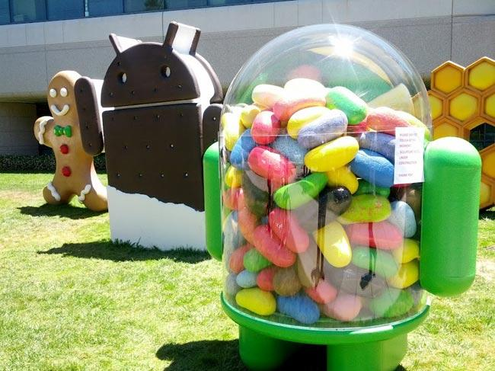
iOS
aa
Android
Notes:
http://www.theverge.com/2011/12/13/2612736/ios-history-iphone-ipad

Slide 5
Background
The first thing our group did was do background research on both Android and iOS mobile devices and their security implementations.
Wikipedia
IUCAT
Google Scholar
Our Own Admittedly Basic Knowledge

Slide 6
Security Measures - Both OS
All apps run in a sandbox. If an attack occurs on a particular program it is isolated from the rest of the other functions on your phone.
Both official application stores (Google Play, App Store) have security measures in place to prevent malicious apps being downloaded.

Slide 7
Security Measures: What about virus protection?
There are numerous virus protection programs that can theoretically contain a breach once one is found. However, they are largely ineffective for two reasons: Sandboxing, and Root Access.

Slide 8
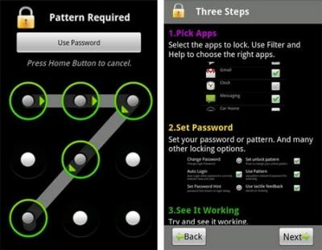
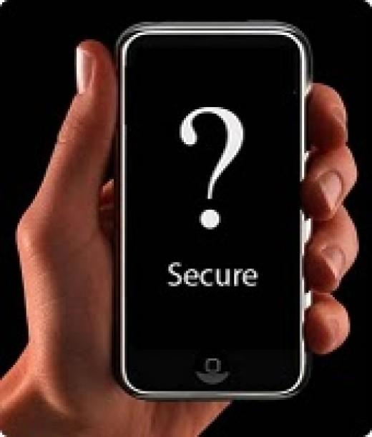
Security Measures: Sandboxing
All apps are sandboxed within a phone so the threat of a virus threatening the entire phone this way is minimal.

Slide 9
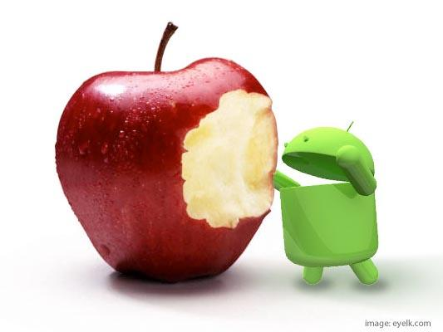
Security Measures: Root Access
In all apps, root access isn't possible with apps. This includes "virus protection apps". Therefore, if a virus were to infect in one place on the phone, a virus program will be very limited in its ability to isolate the problem and eradicate it.

Slide 10
Video

Slide 11
Research Methodology
2 forms of research: Survey, Interview
Two goals with each
  Survey
    See how knowledgeable the general public was in regards to public security.
    Determine if there was something we should focus on more.
  Interview
    Find out how dangerous a security breach could possibly be
    Determine ultimately if such an attack could be made on the os, and if so, how likely

Slide 12
Survey Results
https://qtrial.qualtrics.com/CP/Report.php?RP=RP_1LVdxkqu99iVU6V

Slide 13
1. Do you currently use iOS, Andriod, or Other
# | Answer | Response | %
1 | iOS | 32 | 56%
2 | Android | 19 | 33%
3 | Other | 6 | 11%
 | Total | 57 | 100%

Slide 14
2. What do you use your mobile phone for? (select all that apply)
# | Answer | Response | %
1 | Banking | 28 | 49%
2 | Shopping | 19 | 33%
3 | Navigation | 43 | 75%
4 | Texting | 54 | 95%
5 | Emailing | 43 | 75%
6 | Gaming | 32 | 56%
7 | Other | 15 | 26%

Slide 15
3. Do you think the operating system you're using is secure enough?
# | Answer | Response | %
1 | Yes | 40 | 70%
14 | NO | 14 | 25%
21 | I | 3 | 5%
 | Total | 57 | 100%

Slide 16
4. About how many mobile device are infected with some type of malware?
# | Answer | Response | %
1 | 0-20% | 19 | 33%
2 | 21-40% | 18 | 32%
3 | 41-60% | 11 | 19%
4 | 61-80% | 5 | 9%
5 | 81-100% | 4 | 7%
 | Total | 57 | 100%

Slide 17
5. Are you currently aware of access permissions that applications have on your phone?
# | Answer | Response | %
1 | Yes | 30 | 53%
2 | No | 26 | 46%
3 | I don't care | 1 | 2%
 | Total | 57 | 100%

Slide 18
6. Do you access mobile banking on your mobile device?
# | Answer | Response | %
1 | Yes | 32 | 56%
2 | No | 24 | 42%
3 | I have no idea what you're talking about | 1 | 2%
 | Total | 57 | 100%

Slide 19
7. Have you ever experienced a security breach on your phone?
# | Answer | Response | %
1 | Yes | 4 | 7%
2 | No | 42 | 74%
3 | No clue | 11 | 19%
 | Total | 57 | 100%

Slide 20
8. Have you ever downloaded an Application that wasn't in the android market?
# | Answer | Response | %
1 | Yes | 7 | 37%
2 | No | 9 | 47%
3 | I don't know | 3 | 16%
 | Total | 19 | 100%

Slide 21
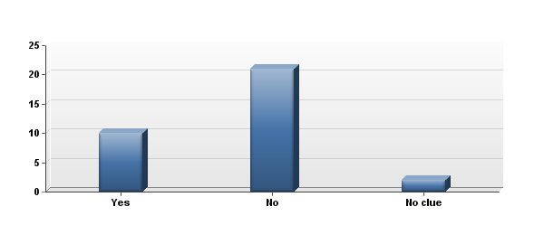
9. Have you ever downloaded Apps, Plugins, Themes, Ringtones, or Games from 'Cydia'

Slide 22
9. Have you ever downloaded Apps, Plugins, Themes, Ringtones, or Games from 'Cydia'
# | Answer | Response | %
1 | Yes | 10 | 30%
2 | No | 21 | 64%
3 | No clue | 2 | 6%
 | Total | 33 | 100%

Slide 23
Interview
https://vimeo.com/54326306

Slide 24
Interview Analysis
After the interview, 4 main points became evident:
Most security breaches are self-inflicted.
iOS and Android have similar permissions when it comes to their respective app stores (although Apple wins here because without jailbreaking you can only download from their app store).
The focus should be on the prevention of breaches, not containment.
Traditional viral programs won't be popular (at least currently) because of the strain it causes on a smartphone (slowdown, crashes, etc).

Slide 25
Conclusion
After all of our research we came to 2 conclusions.
Both companies have relatively rare occurrences of attacks on their operating systems. The ones that do are mostly due to circumventing the security measures already implemented (Jailbreaking, and ignoring permissions when downloading apps being the most typical offenders).
Although both iOS and Android operating systems are different from a design standpoint, as well as their stance on the development of their OS (Open vs Closed Source). Both are similar in their approach to security. Keep it secure from the beginning, so that a fix doesn't have to be released later.

Slide 26
Conclusion - Apple wins...
On paper, it appears that Apple's iOS is the more secure system as it only allows you to download apps through their store. In addition the low amount of changes allowed to the system (and only by Apple no less) due to their closed source mentality means that it's pretty difficult to find a security breach in the code for iOS that can't be easily patched up. Compare that to Android that has hundreds, if not thousands, of devices (some up to date, some decidedly less so) that each run unique versions of their OS.

Slide 27
Conclusion - ...but Android wins too...
However, Android's OS main advantage is that it's way more forthcoming with information. A malware program, Bouncer, scans all apps on the Google Play store for malicious apps. There may be a similar program in the Apple store, but nothing has be said on the matter. In addition, if an attack should occur, there will be a more likely chance that the open source community will have a solution available quickly. This ability to work together simply isn't possible under Apple's current stance on the changes of iOS

Slide 28

Conclusion: ...they both lose.
Both Android and Apple have an inferior permissions model that allow malicious apps masquerading as legitimate apps to transmit undesired information to third parties. Although avoidable, these are often the most common way a security breach can occur on your phone.

